Slide 1
KIDS PLAY
Guide : Kaushalya Thopate mam.
Name : Akash Vinayak Bhandari.
Div. : A{31}
Subject : Mobile Applications and Development {ES 1037}

Slide 2
INTRODUCTION
It is one of the best learning mobile application for kids
This app contains various sections like listen and guess ,look and guess
the attractiveness of this application enhances the attention of kids towards study
This app is overall based on practical based learning.
This app can start the journey of education in an enjoyable manner.

Slide 3
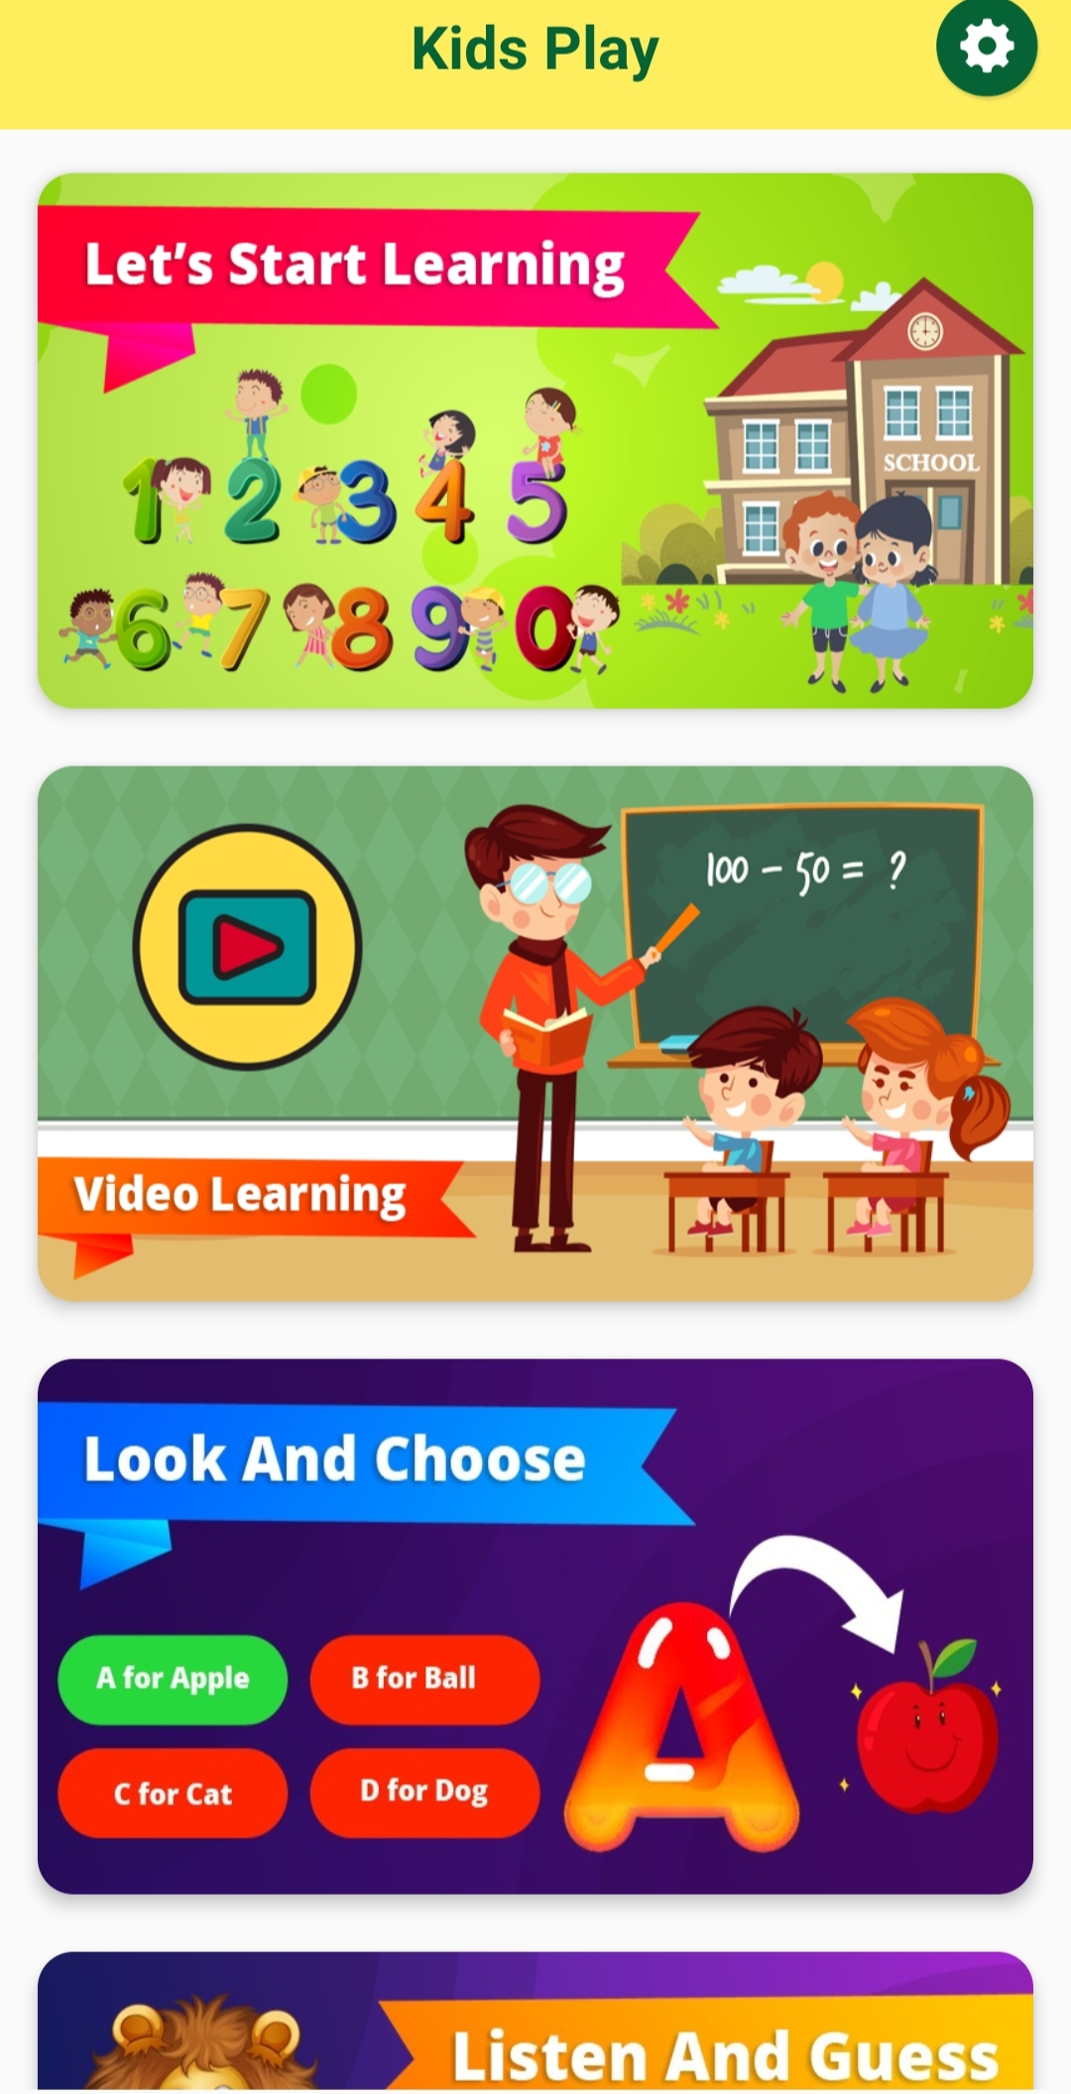
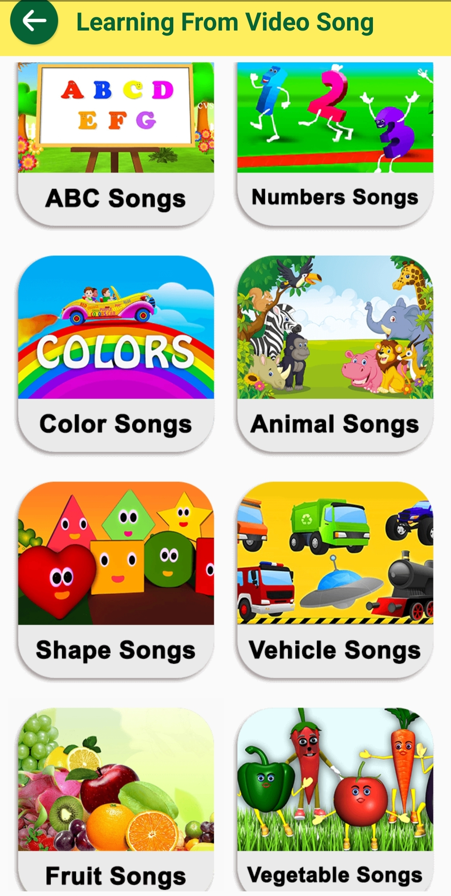
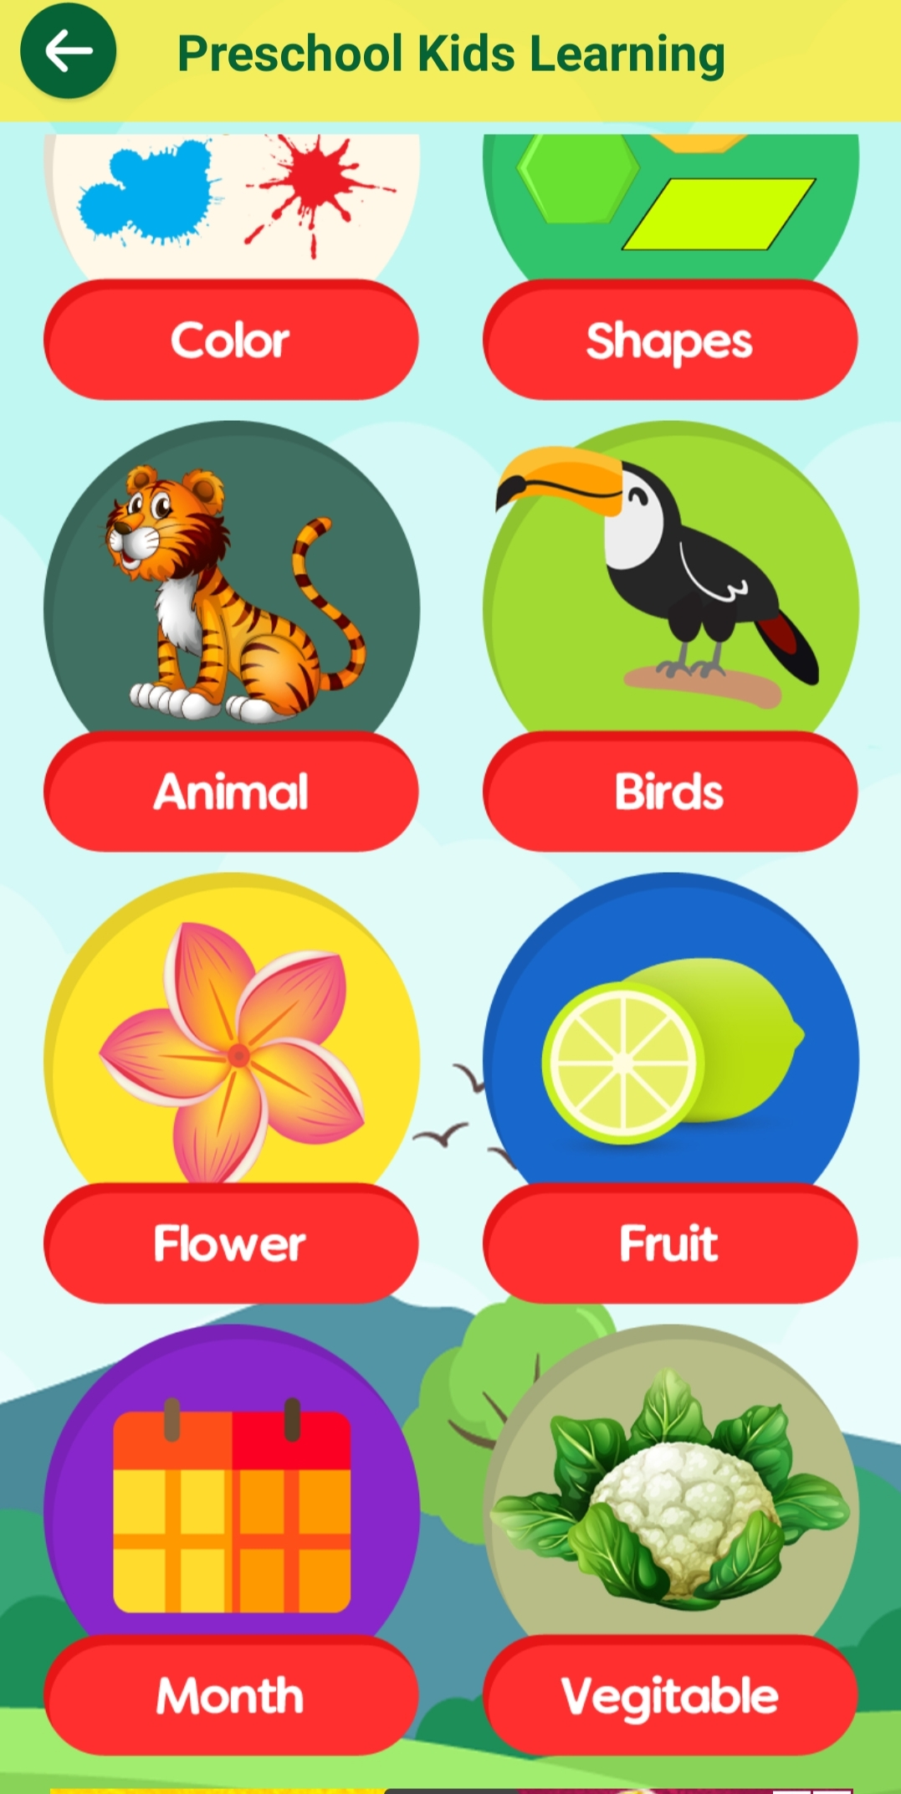
VISUALS

Slide 4
OBjECTIVES
The design and graphics of this application holds kids attention towards it which results in being familiar with the numbers and alphabets.
This app can help kids to remember different things via catchy rhythms and songs which contains all the important information that they should know.
Next objective of this application is to throw out the fear of kids towards the studies
and create a desire to learn much more .

Slide 5


TOOLS AND TECHNOLOGIES USED
Language used : java
Emulator: AVD manager and phone debugging
Users interface: XML(extensible markup language)layouts
Software dev. Kit(SDK): collection of software development tools containing JDK/JRE compiler , debugger and software framework

Slide 6
BEST FEATURES
section wise topics distribution
more than enough content available
realistic video animations
overall sophisticated arrangement
refreshing environment via smooth and catchy background music
secured privacy policy availability

Slide 7
THANK YOU

